Slide 1
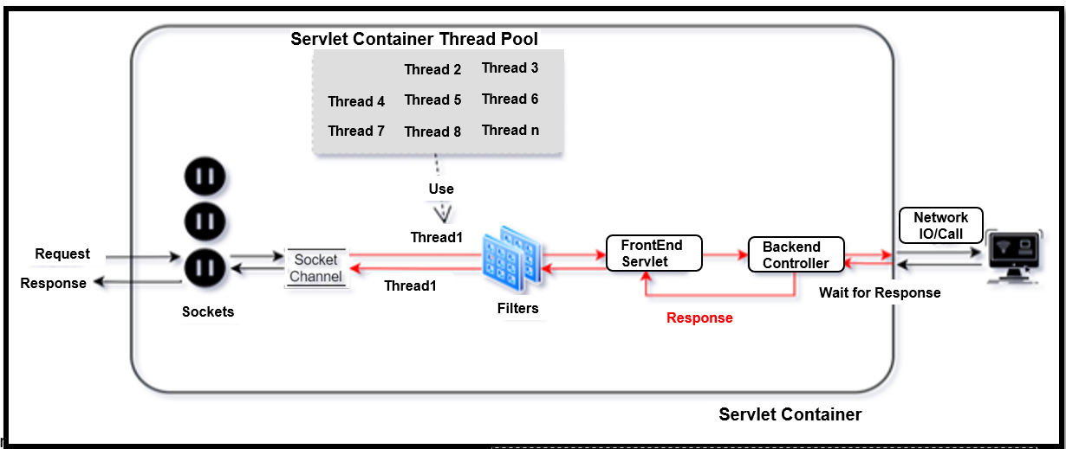

Slide 2
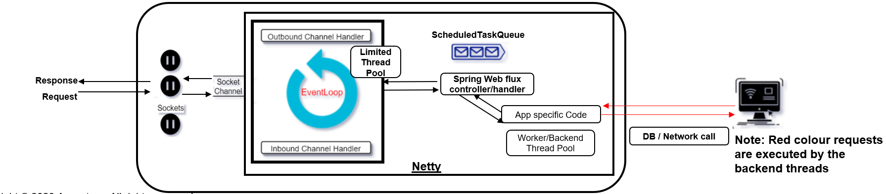

Slide 3
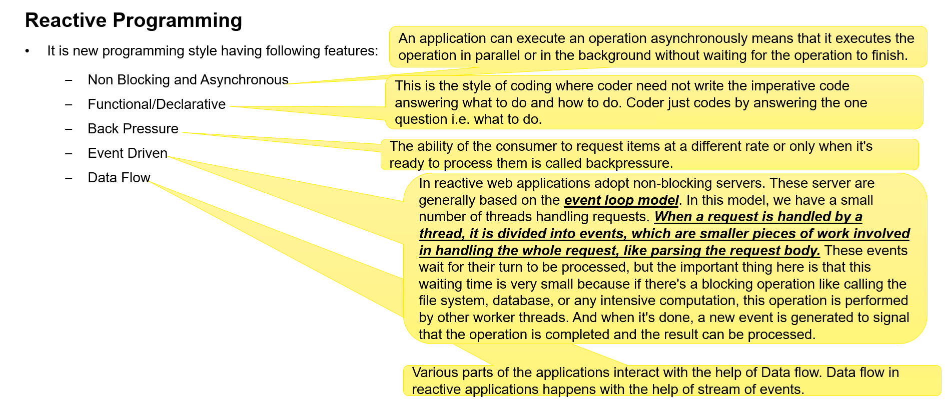

Slide 4
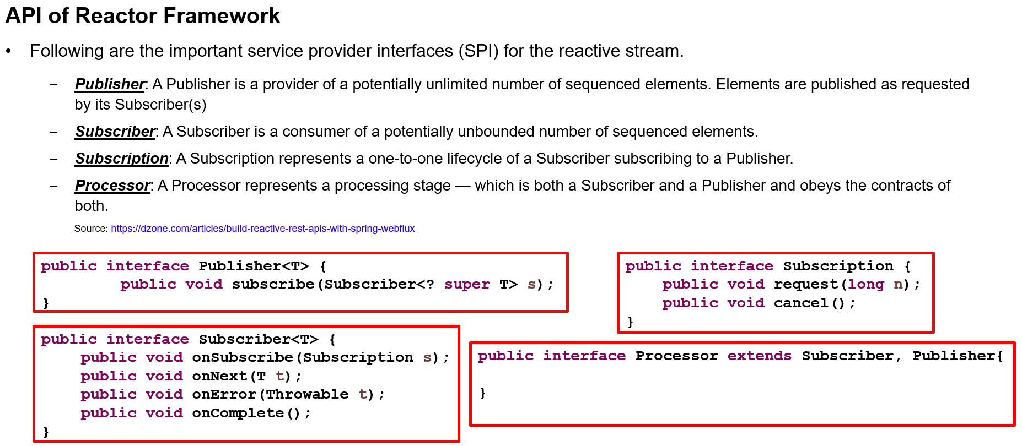

Slide 5
Reference link
Servlet Container Model
https://www.quora.com/How-do-servlets-handle-multiple-requests
Spring Webflux: EventLoop vs Thread Per Request Model
https://dzone.com/articles/spring-webflux-eventloop-vs-thread-per-request-mod
https://reflectoring.io/getting-started-with-spring-webflux/
https://stackoverflow.com/questions/27765547/how-does-a-single-servlet-handle-multiple-requests-from-client-side
Map vs flatMap
https://stackoverflow.com/questions/49115135/map-vs-flatmap-in-reactor
https://nikeshshetty.medium.com/5-common-mistakes-of-webflux-novices-f8eda0cd6291

Slide 6
Reference link
The difference between onErrorResume and doOnError
https://stackoverflow.com/questions/58167842/the-difference-between-onerrorresume-and-doonerror
SpringBoot 3:
1.Jetty is not compatible with SpringBoot 3(Netty + below spring boot 3 - having connection dropout issue hence Jetty is recommended)
2.Netty supports SpringBoot 3, we don't see any connection dropout, its working fine

